Slide 1
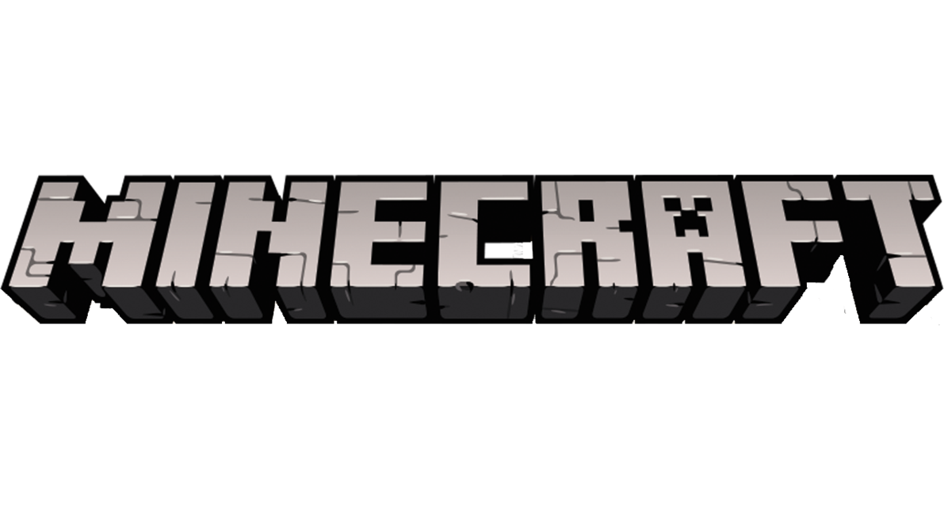
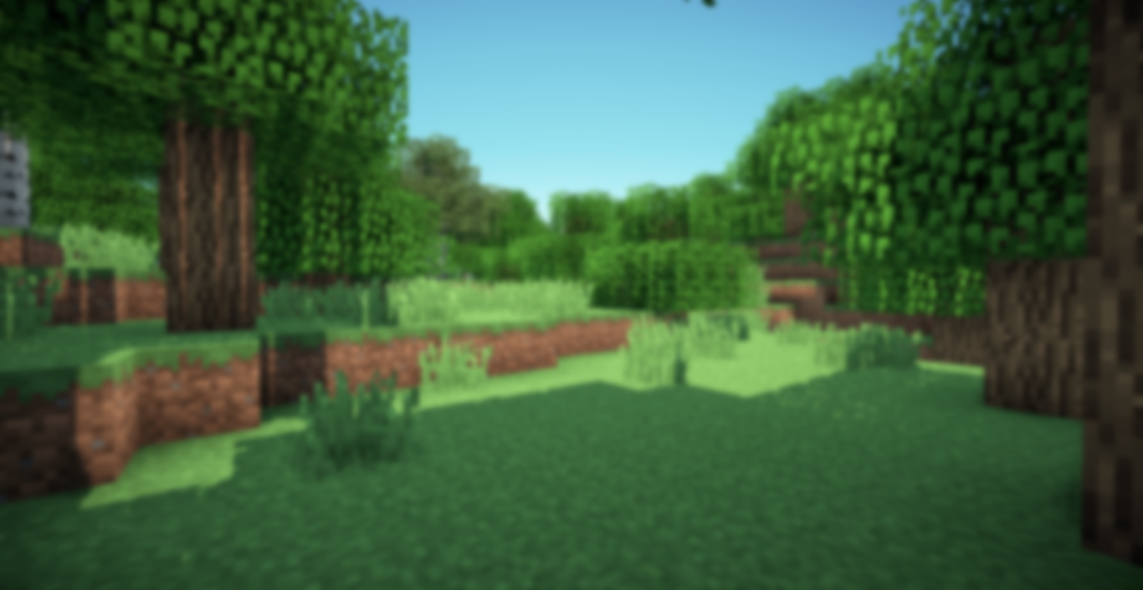
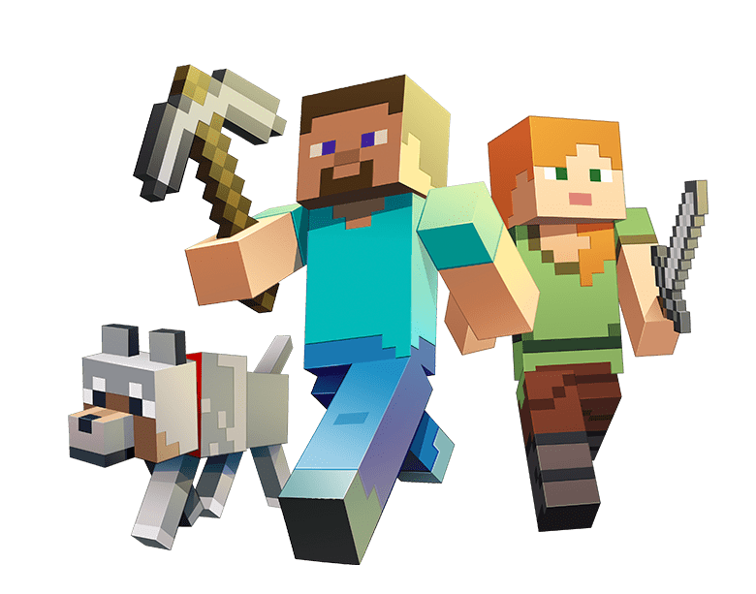
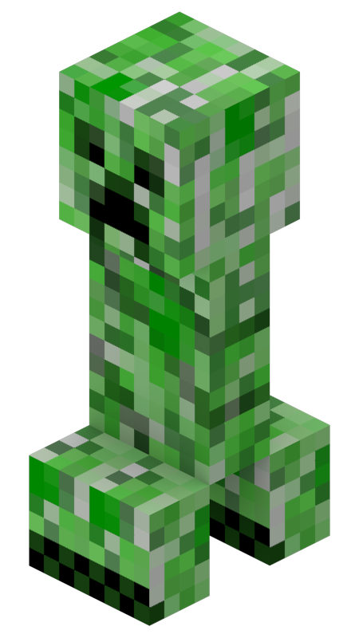
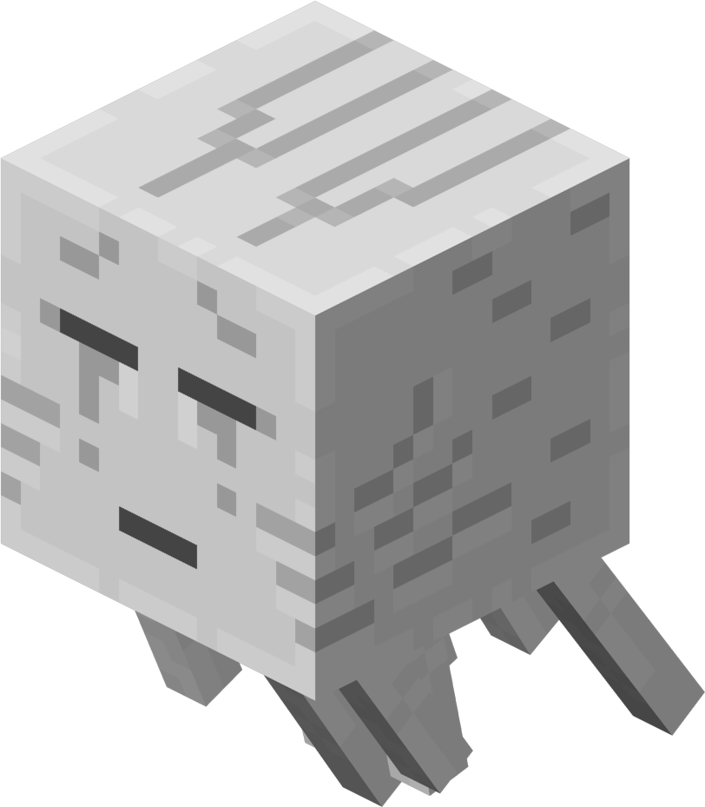
What do players do in the game?
What do players do in the game?
Start the Game
Options.
Quit
Jiamin Chen
Tracy Li
Winter 2025

Slide 2
Loading……

Slide 3
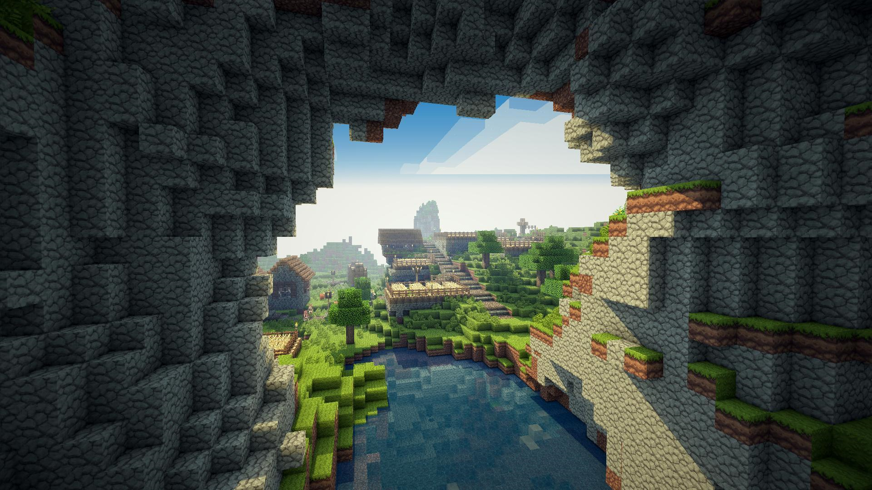
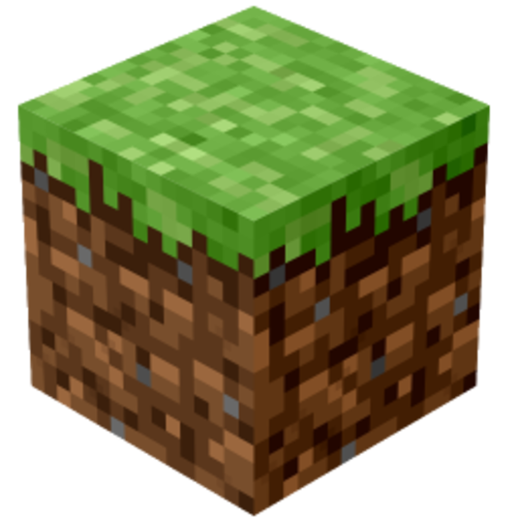
WELCOME
Minecraft is a sandbox video game.
Players can interact with a fully customizable three-dimensional world made of blocks and entities
Diverse gameplay options：survival, creative, adventure, hardcore, spectator

Slide 4

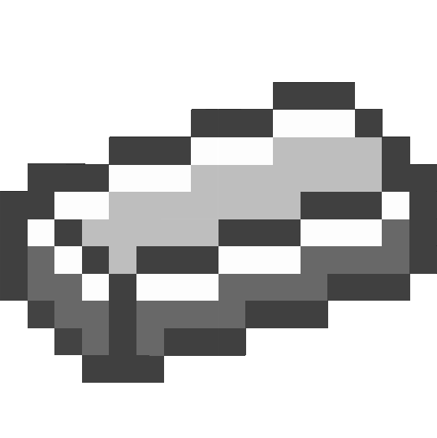
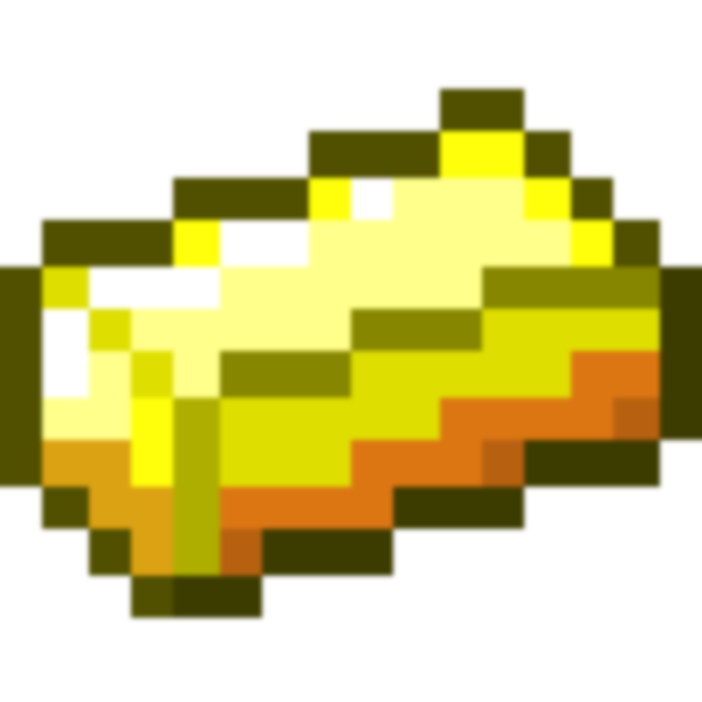
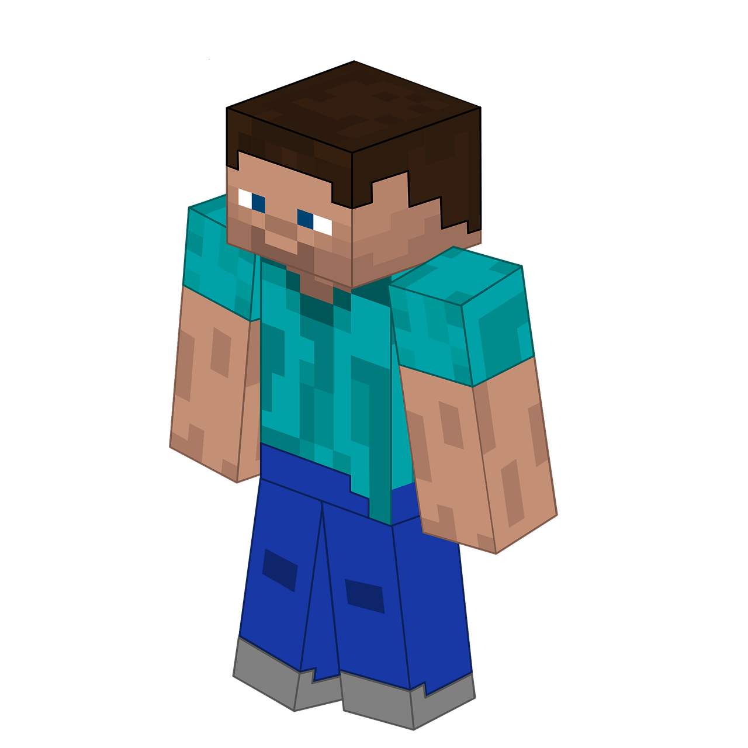
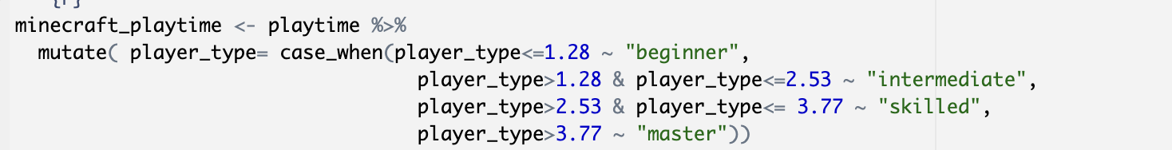
Data and Cleaning
Data from:
kaggle “Minecraft Gaming User Data”
https://www.kaggle.com/datasets/manandkumar/minecraft-gaming-user-data
15,000 rows and 25 columns
Cleaning:
Filter out survival players in PC
Categorize players in four groups by their play time
Final data: 1,241 entries, 26 total columns

Slide 5
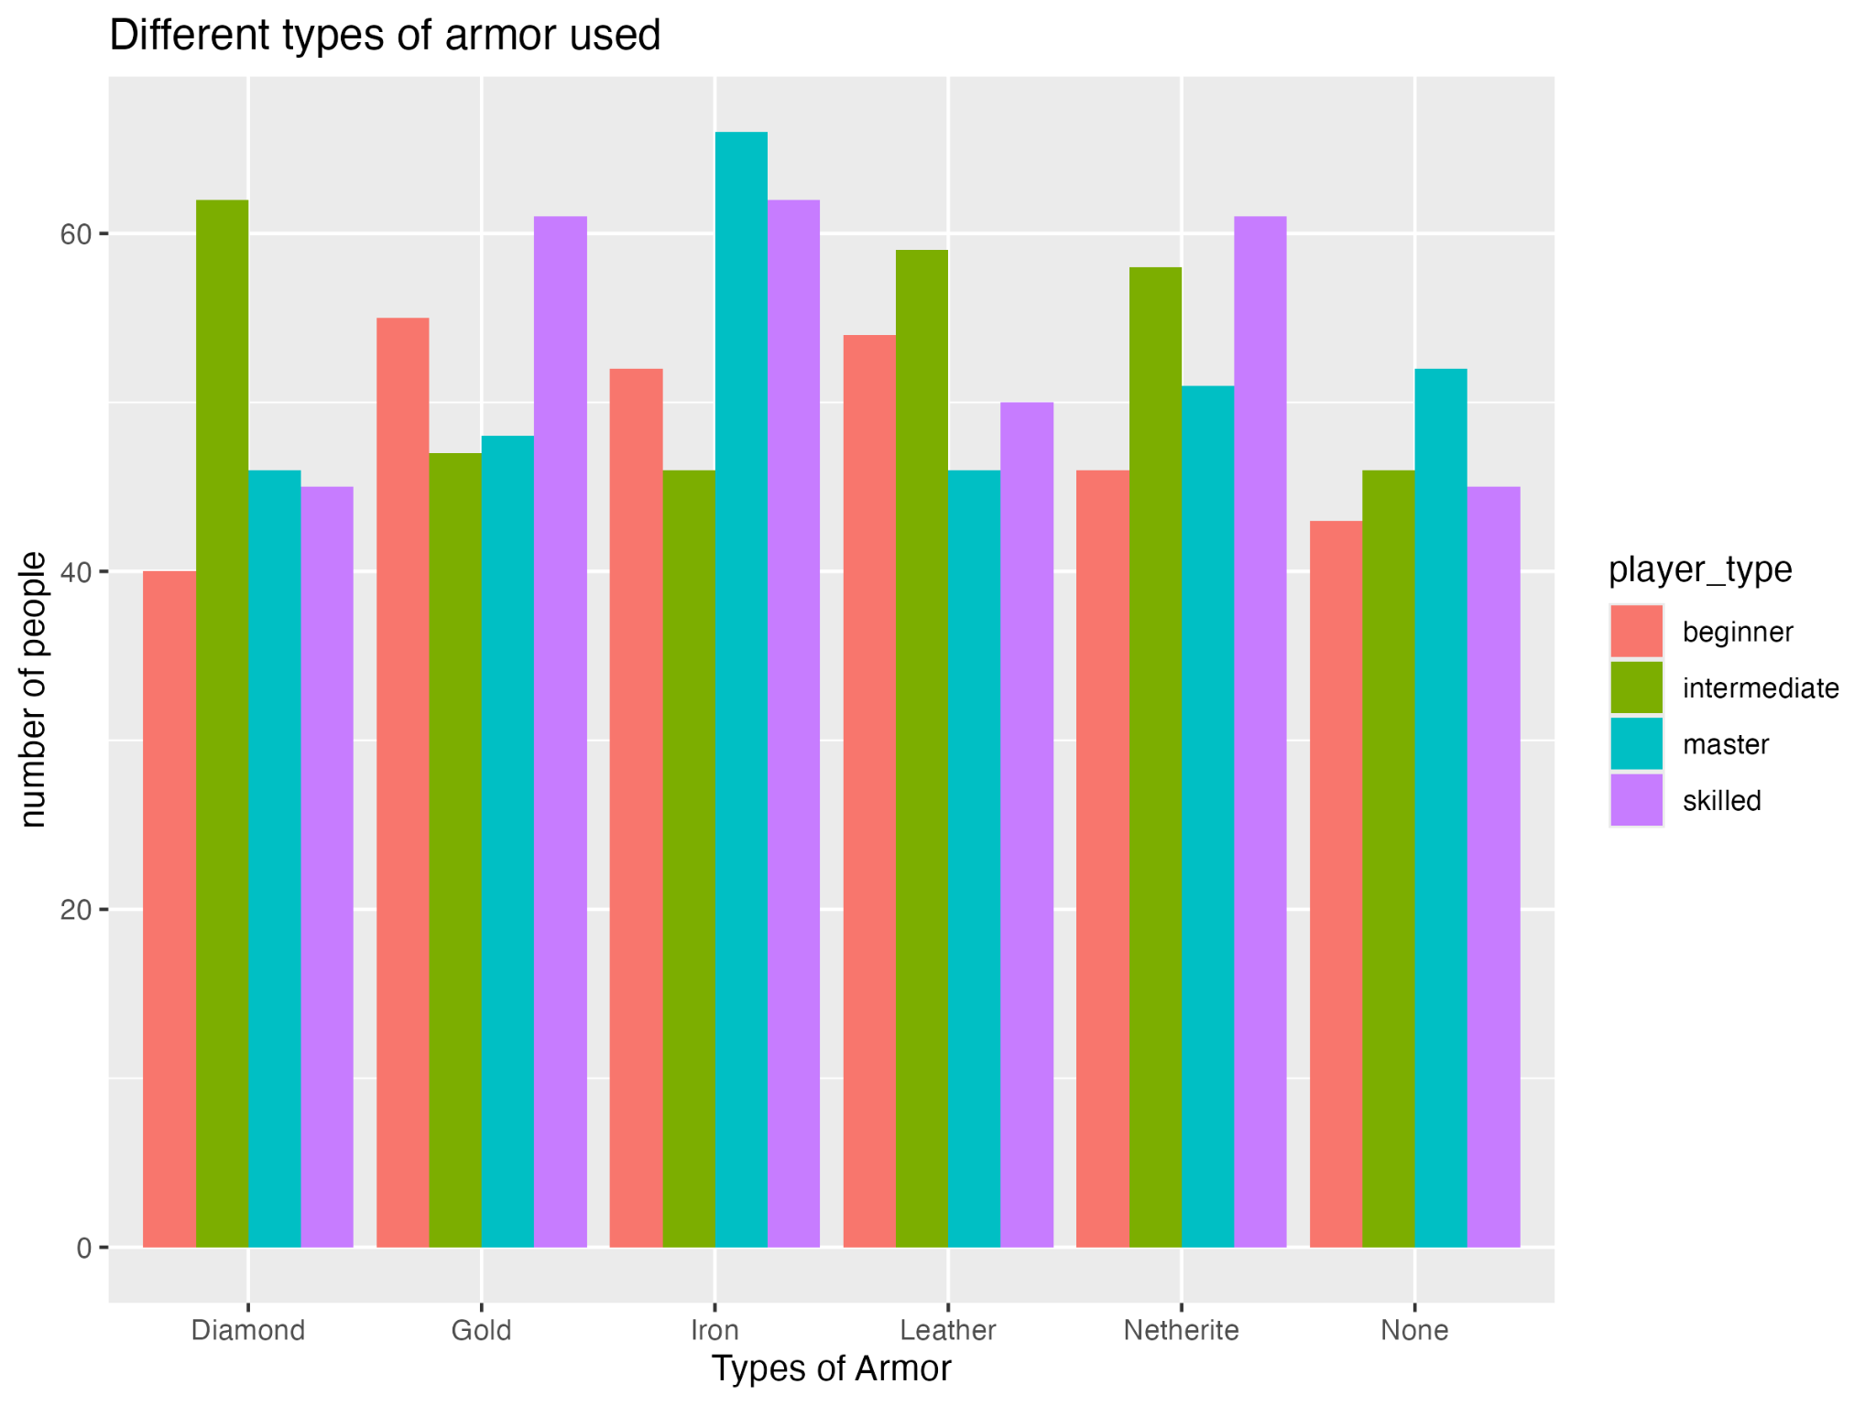
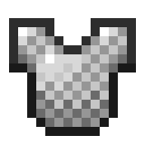

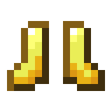

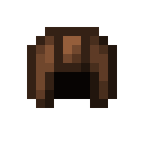
Result
Armor
Tools
Biomes
Blocks
master and skilled player prefer iron armor
while beginners prefer golden armor

Slide 6
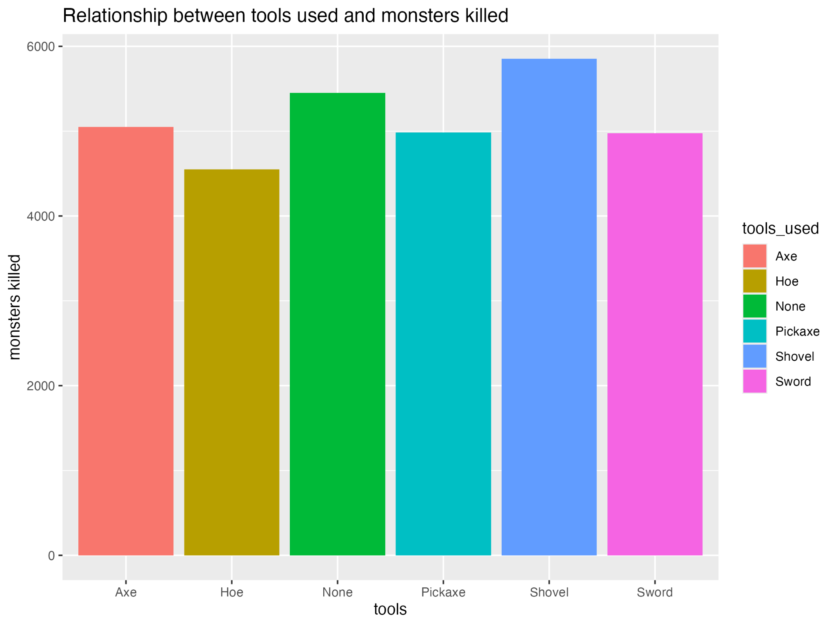
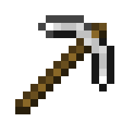
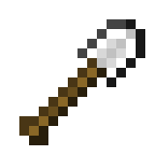
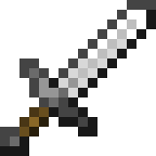
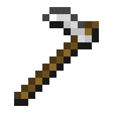
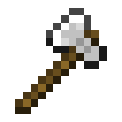
Result
Armor
Tools
Biomes
Blocks
players using shovels kill most of monsters (surprising)
players using hoes kill least

Slide 7
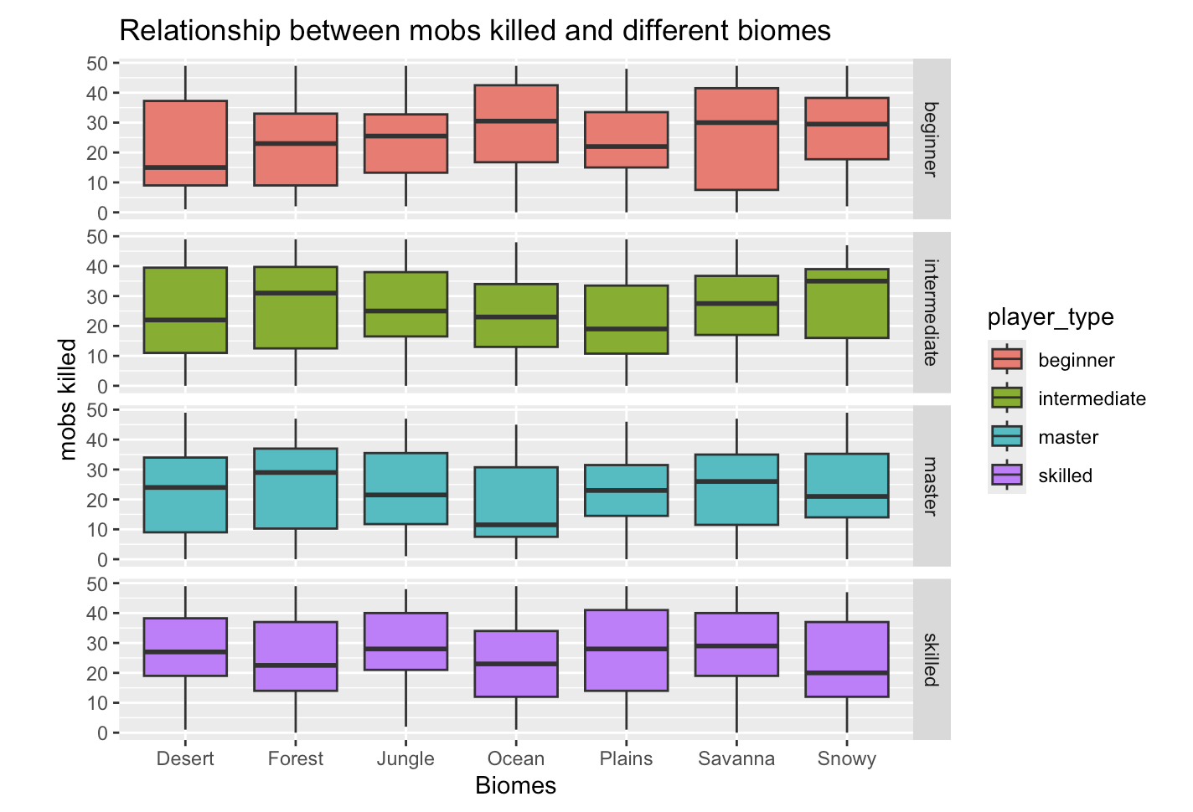
Result
Armor
Tools
Biomes
Blocks
overall, the number of mobs killed are higher in those biomes with more diversable mobs (forest, jungle, plains)

Slide 8
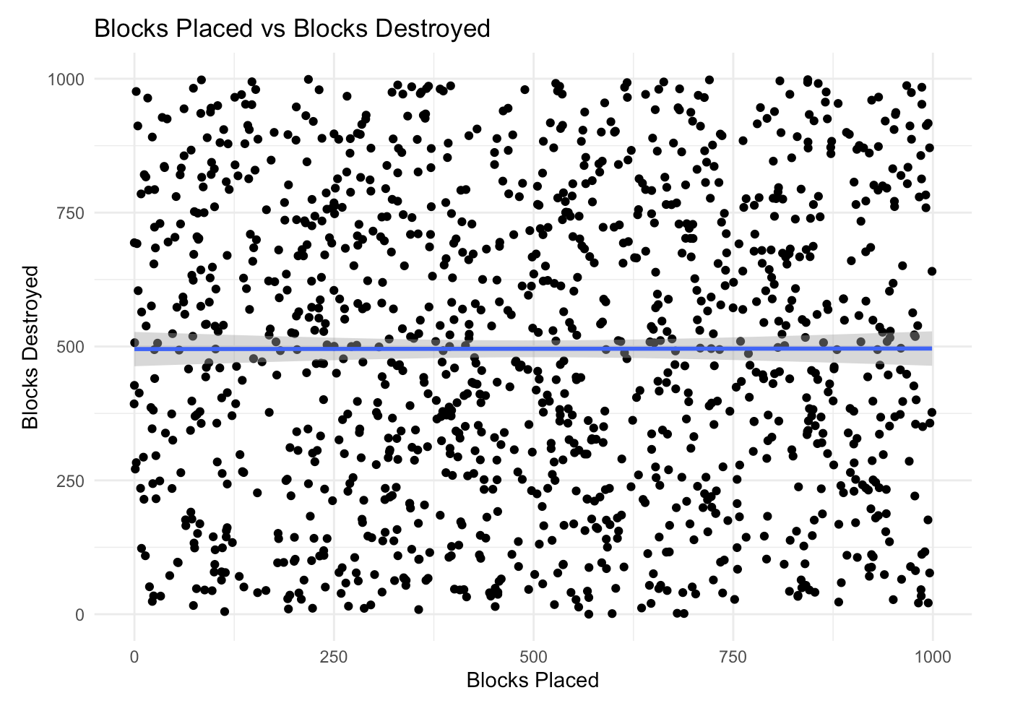

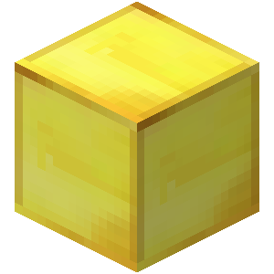
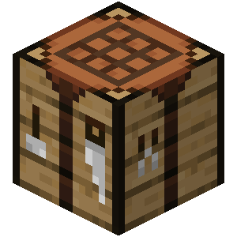
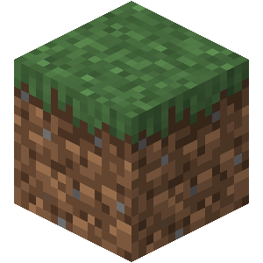
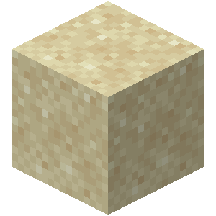
Result
Armor
Tools
Biomes
Blocks
Sustainable gaming?
No correlation between blocks Place & destroy

Slide 9
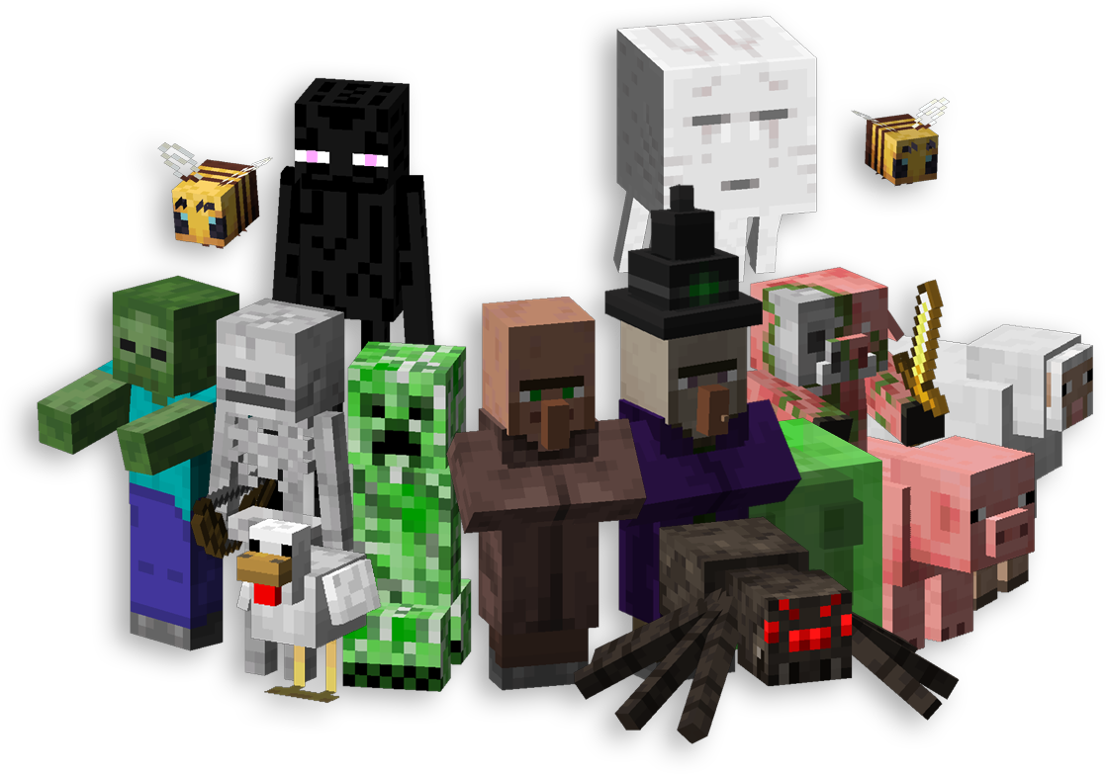
Conclusion
In conclusion, it is hard to predict human behavior in this highly free game, people can do whatever they want in the game

Slide 10
THANK
YOU
Quit
Restart
Stay green & play games

